Slide 1














Stream Analytics

Slide 2
The Steps:
Input
IoT Device
IoT Hub
Process
Query Definition
Run Job
Output
Files
Dashboards & Reports
Get References
…

Slide 3


Data ….
2
3
4
3
4
5
Input
2
3
4…
All Data
Output
SELECT *
INTO Output 1
FROM Input
Stream Analytics
{2s}
{2s}
{2s}
Grouped 2s Data
SELECT ….
INTO Output 2
FROM Input
WHERE
GROUP BY TumblingWindow (second,2)

Slide 4
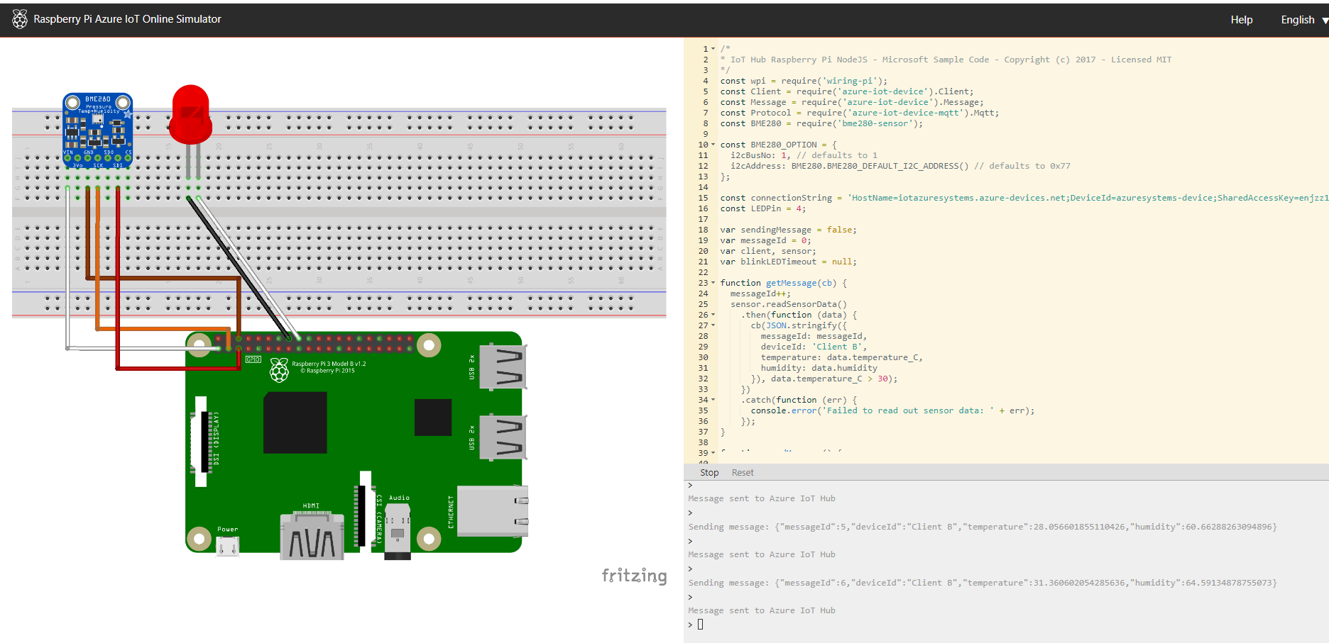
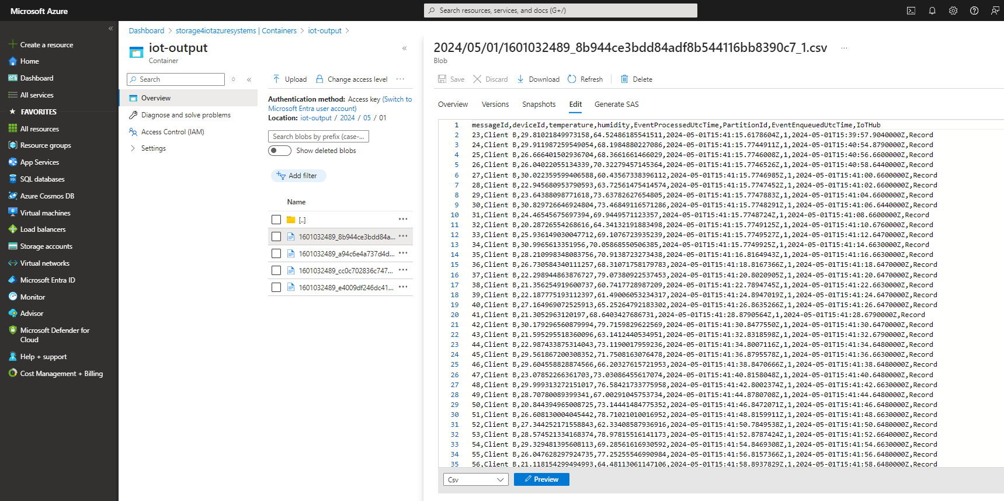
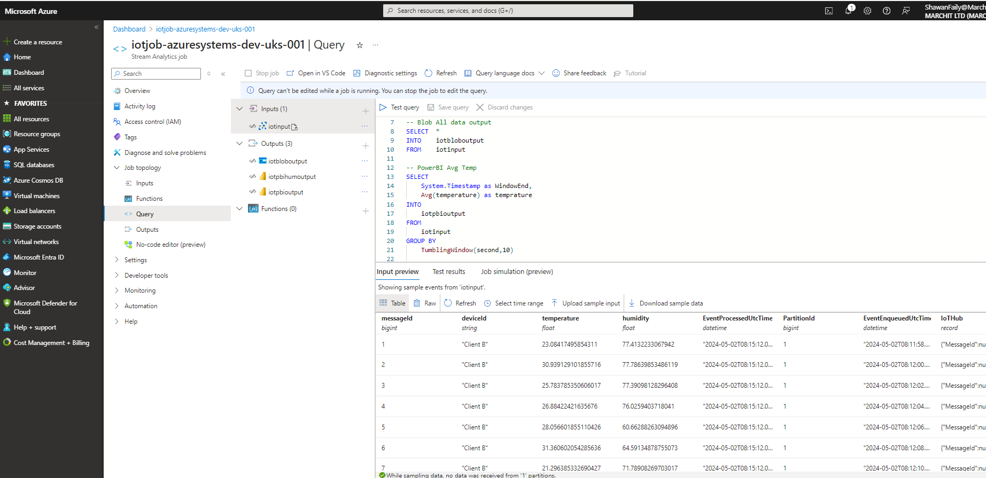
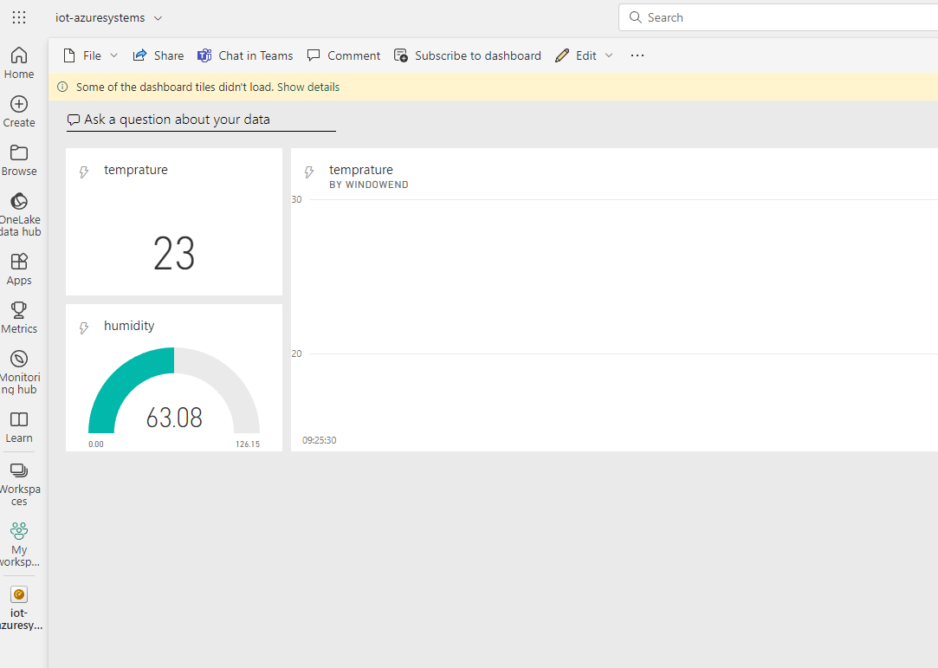
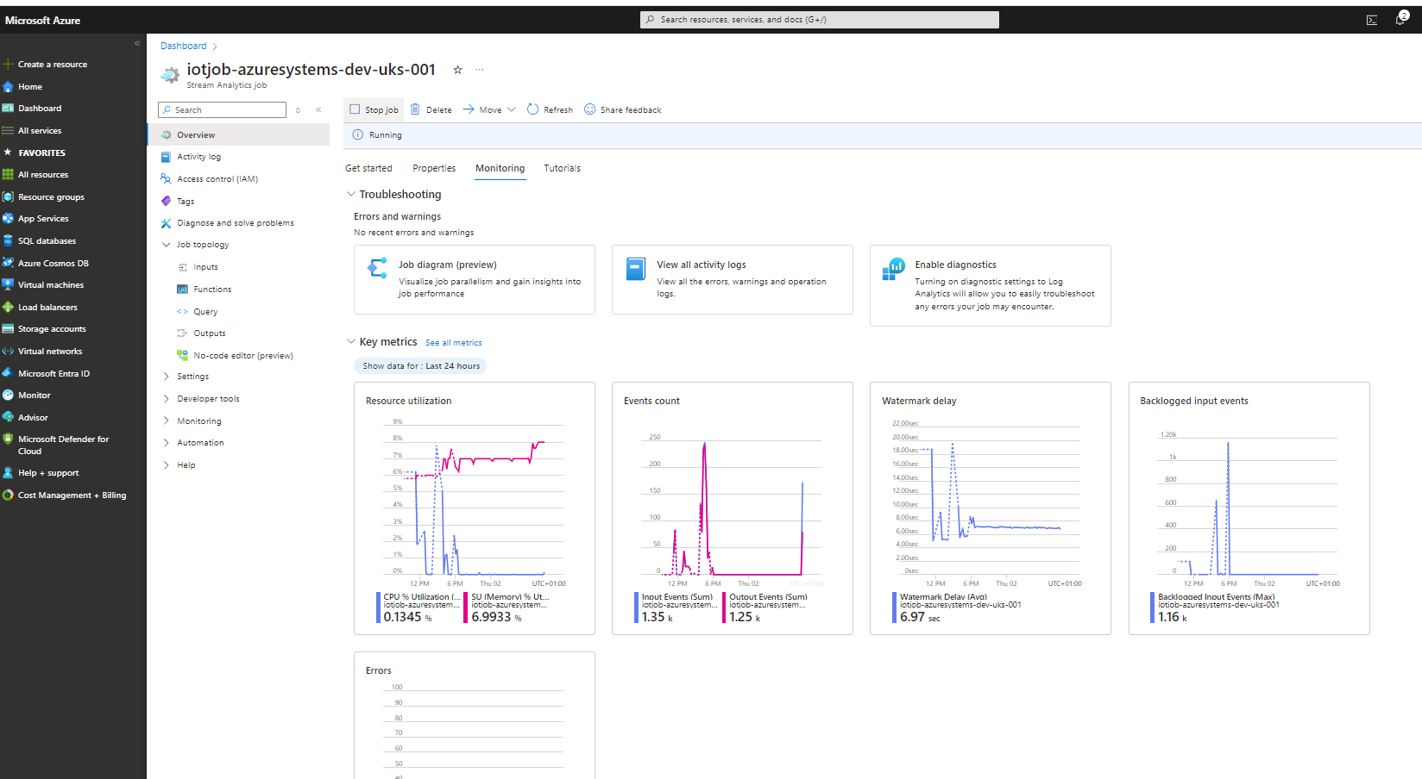
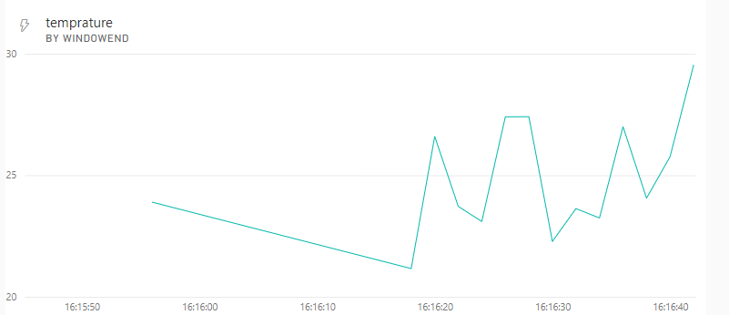
Input
Output

